Slide 1
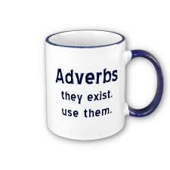

Module 4
adjectives and adverbs

Slide 2

Adjectives
An adjective says something about a noun.
Examples: a nice person
a good book
old friends

Slide 3

Adverbs
Adverbs say something about a verb.
They ad someting to the verb.
They can also ad something to adjectives or other adverbs.
Examples:
We walk to school. - We walk to school daily.
We stopped working. - We stopped working suddenly.
We run. - We run fast.

Slide 4

Form of adverbs
Regular = adjective + ly
Examples: quick – quickly
sad – sadly
nice – nicely

Slide 5

Form of adverbs
If the adjective already ends in – y, you replace the –y by – ily
Examples: noisy – noisily
happy - happily

Slide 6
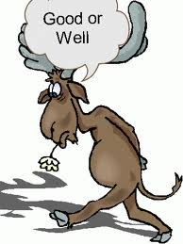
Form of adverbs
- Irregular: good – well
Examples: He is a good cook.
He cooks well.
- Some adjectives never change: fast / hard
Example: He is a fast runner. / He runs fast.

Slide 7
How and why?
The meaning of a saying can change if you use an adjective or an adverb.
verb | used with an adjective | used with an adverb
look | look good (= appearance) | look well (= healthy)
feel | feel good (= state of health/mind) | feel well (= have a good sense of touch)
smell | smell good (= odour) | smell well (= have a good sense of smell)
taste | taste good (= preference) | taste well (= have a good sense of taste)

Slide 8
Online exercises
http://www.englisch-hilfen.de/en/exercises/adjectives_adverbs/adjective_adverb.htm
http://www.englisch-hilfen.de/en/exercises/adjectives_adverbs/adjective_adverb2.htm
http://www.ego4u.com/en/cram-up/grammar/adjectives-adverbs/exercises
http://www.ego4u.com/en/read-on/countries/usa/tour/niagara-falls#exercises
http://www.harcourtschool.com/activity/adverb_trail/index.html

Slide 9
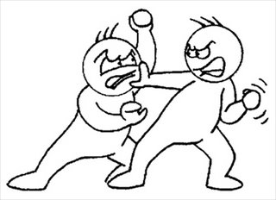
Past Simple vs
Present Perfect

Slide 10
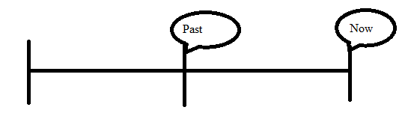
Past Simple
‘Action’ started and ended in the past
Clear indication of time!
E.g. in 1997, yesterday, last week, two days ago.

Slide 11
How to make a Past Simple
verb + ed, e.g. word+ed = worked
Be careful!
Verbs which end in –e only get a -d.
E.g.: love – loved, like - liked
Verbs which end in a consonant (medeklinker) + y get –ied.
Study – studied, hurry – hurried
Irregular verbs: 2nd column in your document

Slide 12

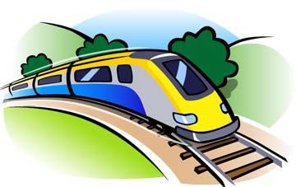
Examples
Last year, she worked at the movie theater after school.
The train passed five minutes ago.
He went to Amsterdam yesterday.

Slide 13
Key words
Last night, last week, last month, last year
This morning
At eight o’clock
In 2009
Yesterday
A few years ago

Slide 14
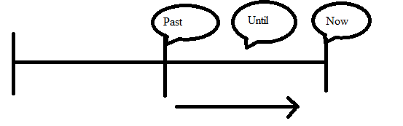
Present Perfect
Started in the past and still going on.
Happened in the past and the result is important now.
No clear indication of time.

Slide 15
How to make a Present Perfect
I, you, we, they + have + past participle
He, she, it + has + past participle
Past participle is verb + ed
Irregular verbs: 3rd column in your document.

Slide 16
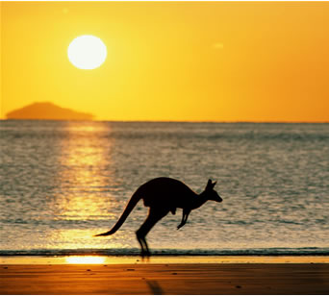

Examples
School has not started yet.
I have never been to Australia.
I have lost my key.

Slide 17
Keywords
Aan bepaalde woorden kun je ‘zien’ dat je de Present Perfect moet gebruiken. Enkele daarvan zijn samen te vatten in ‘fyne jas’.
Fyne jas = For Yet Never Ever
Just Already (always) Since
Als er helemaal geen tijdsaanduiding in de zin staat is het vaak een Present Perfect!

Slide 18
Schedule
Past Simple Ww + ed | Present Perfect Have of has + voltooid deelwoord
In het verleden begonnen en beëindigd | In het verleden begonnen en gaat nu nog door
I saw three movies last week. | I have seen three movies this week. (de week is nog niet voorbij)
Duidelijke tijdsbepaling | Geen duidelijke tijdsbepaling
He played a match yesterday. (tijdsbepaling → yesterday) | He has played a match. (geen tijdsbepaling → Pres. Perf.)

Slide 19
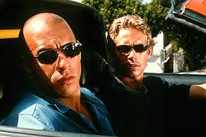
Past Simple vs Present Perfect
The Past Simple is used for completed actions.
I lived in Berkel Enschot for six years. (now I live somewhere else)
Paul Walker made 34 films. (He can’t make any more)
The Present Perfect is used for unfinished actions.
I have lived in Berkel Enschot for 6 years. (I still live there)
Vin Diesel has made 26 films. (he still makes them)

Slide 20
Extra practise
http://www.ego4u.com/en/cram-up/grammar/simpas-preper/exercises?ex05
http://www.ego4u.com/en/cram-up/grammar/simpas-preper/exercises?ex03
http://www.ego4u.com/en/cram-up/grammar/simpas-preper/exercises?ex08
http://www.ego4u.com/en/cram-up/grammar/simpas-preper/tests?test2

